Slide 1

Red Hat System Administration I 10.0
Chapter 3
Dilara Gülenç

Slide 2
Introduction to Linux Manual Pages (man)
Local Documentation: Shipped directly by software packages to provide on-system reference documentation.
Access Method: Queried from the command line interface using the man command.
Filesystem Location: Stored within dedicated subdirectories inside /usr/share/man.
Origin: Derived from the historical Linux Programmer's Manual, divided into multiple sections due to its extensive size.
Collision Resolution: Identical names across different system categories are distinguished by appending their section number in parentheses:
  topic(section)
Comparative Example:
  passwd(1): Documents the executable user command used to update passwords.
  passwd(5): Documents the /etc/passwd file format used for storing local user accounts.

Slide 3
Common Sections of the Linux Manual
Section | Content Type | Description
1 | User commands | Both executable and shell programs
2 | System calls | Kernel routines that are invoked from user space
3 | Library functions | Provided by program libraries
4 | Special files | Device files (e.g., hardware/virtual devices)
5 | File formats | Configuration files and data structures
6 | Games & screensavers | Historical section for amusing programs
7 | Miscellaneous | Conventions, standards, protocols, and file systems
8 | System administration | Privileged commands and maintenance tasks
9 | Linux kernel API | Internal kernel calls
Administrative Priority:
Primary Admin Sections: 1 (Commands), 5 (File Formats), and 8 (Admin Utilities).
Troubleshooting: Section 2 (System Calls) is used with select diagnostic tools; remaining sections serve developer reference and advanced tasks.

Slide 4
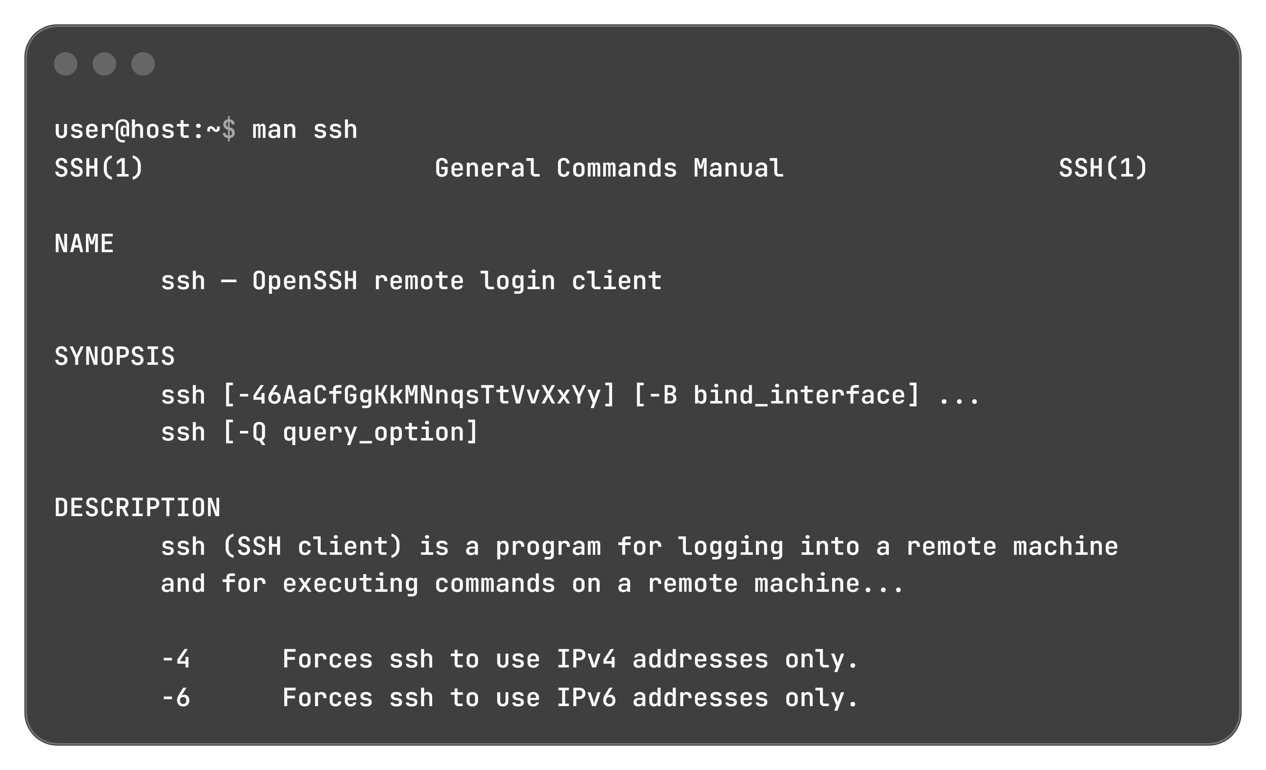
Accessing & Querying Man Pages
Default Search Order: The man utility scans manual sections sequentially in alphanumeric order.
Basic Query Syntax: Run man topic to display the first matching manual page.
Section-Specific Targeting: Target a particular category directly using man section topic (overriding the default search sequence).

Slide 5
Structural Anatomy of a Man Page
Heading | Description
NAME | Subject name (command or file) paired with a brief definition
SYNOPSIS | Syntax summary illustrating execution patterns, flags, and targets
DESCRIPTION | In-depth narrative providing a fundamental understanding of the topic
OPTIONS | Comprehensive explanation of all execution options and flags
EXAMPLES | Real-world usage demonstrations for the utility, function, or file
FILES | Listing of configuration files and system paths linked to the topic
SEE ALSO | Cross-references to related topics, standards, or documentation
BUGS | Documented software flaws, operational limitations, or caveats
AUTHOR | Attribution details for contributors to the project or documentation
Note: Headings follow a consistent order across manuals, though headings that do not apply to a specific topic are omitted.

Slide 6
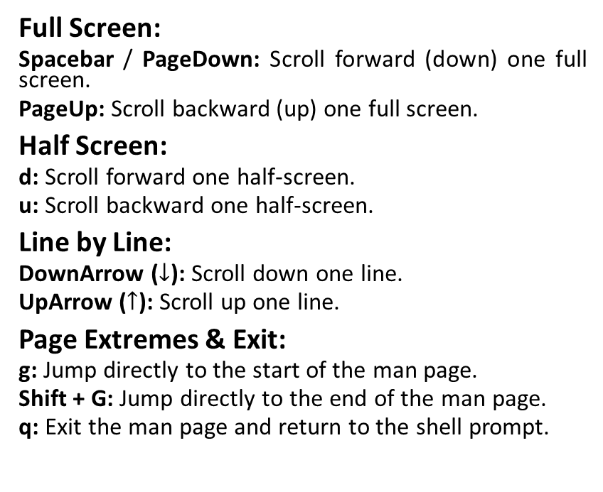
Navigation Controls & Pattern Searching
Full Screen:
  Spacebar / PageDown: Scroll forward (down) one full screen.
  PageUp: Scroll backward (up) one full screen.
Half Screen:
  d: Scroll forward one half-screen.
  u: Scroll backward one half-screen.
Line by Line:
  DownArrow ($↓$): Scroll down one line.
  UpArrow ($↑$): Scroll up one line.
Page Extremes & Exit:
  g: Jump directly to the start of the man page.
  Shift + G: Jump directly to the end of the man page.
  q: Exit the man page and return to the shell prompt.
Search Execution:
/string: Initiates a forward search for the specified pattern. n: Advances to the next search match forward. Shift + N: Repeats the search backward toward the top.
Pattern Matching Caveat:
Searches support regular expressions with metacharacters ($, *, ., ^). Literal strings containing these symbols (e.g., make $$$) can yield unexpected results. Reference regex(7) for full pattern syntax and usage rules.

Slide 7
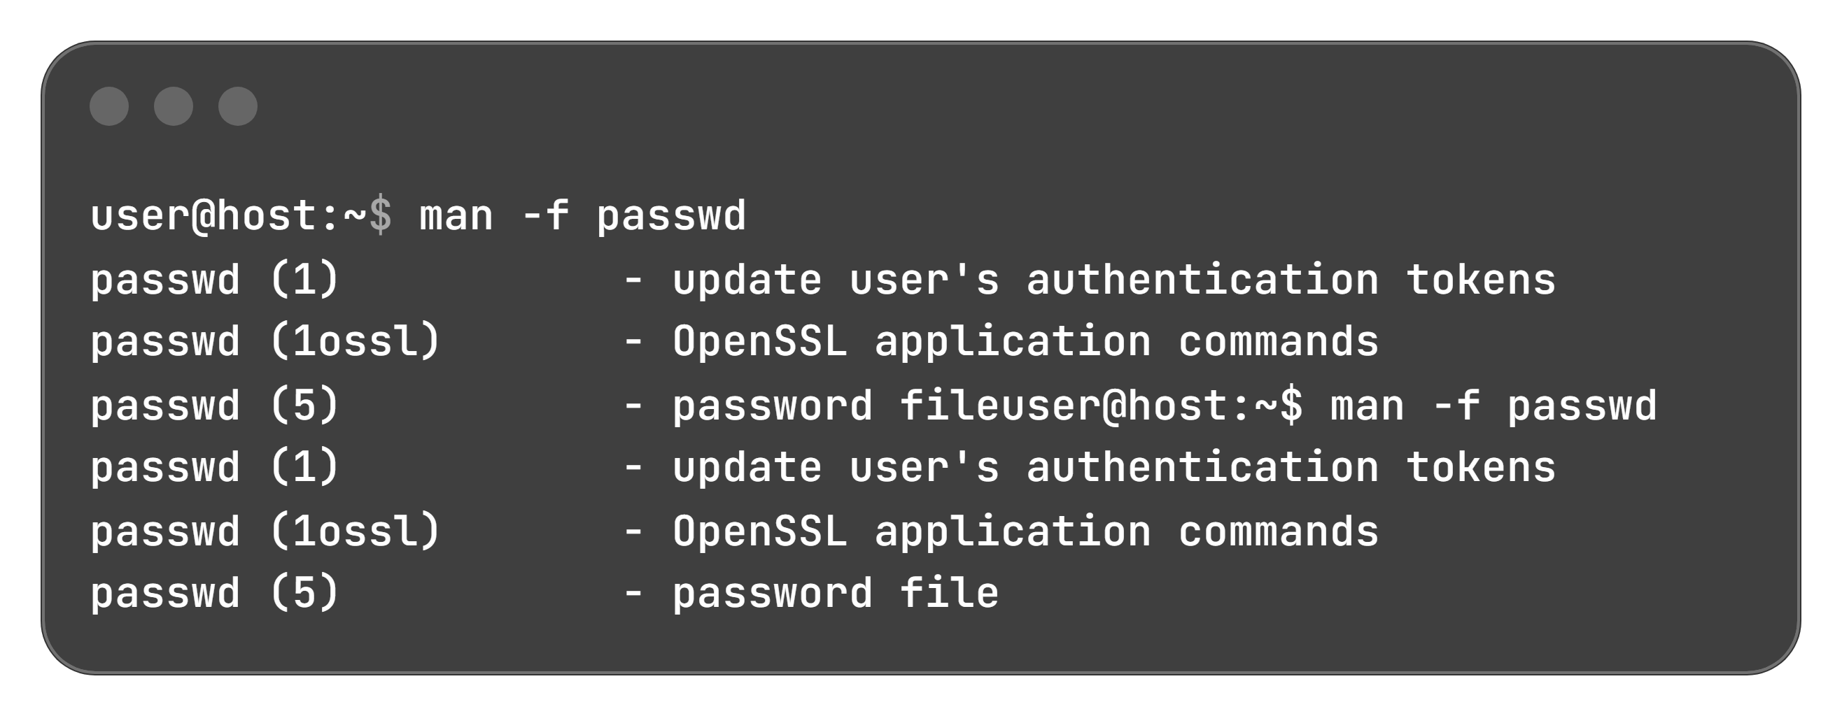
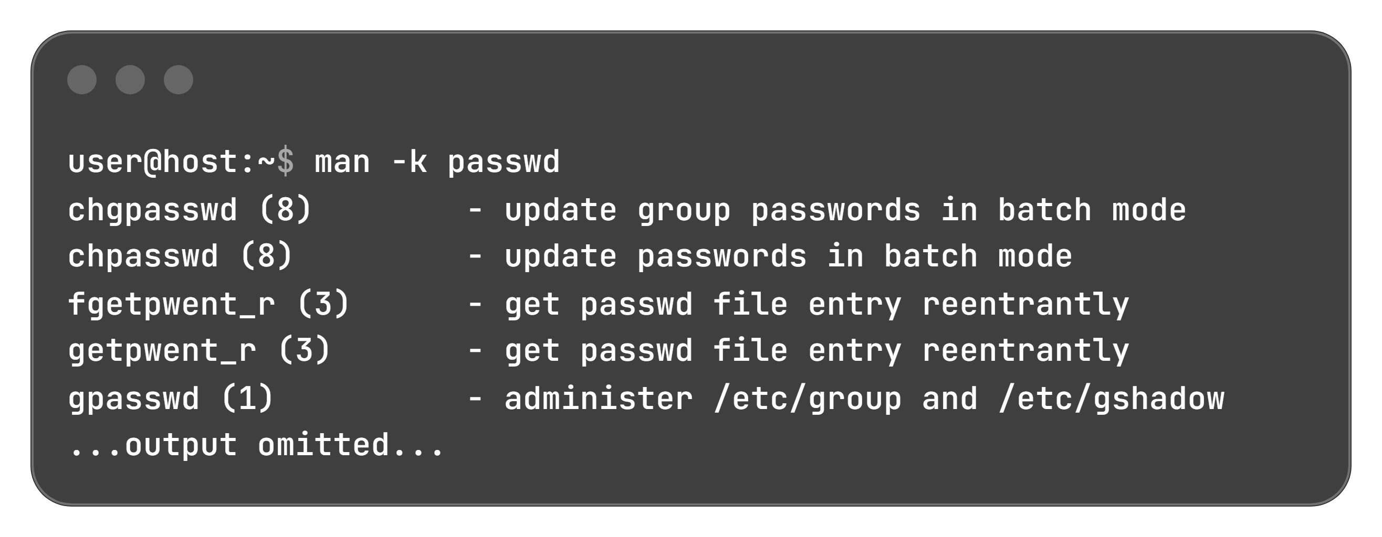
Keyword Search Mechanisms: Titles, Summaries & Descriptions
Target Scope: Searches strictly within manual page titles.
Equivalent Command: whatis
Output Format: Displays a one-line summary for each matching topic:
Target Scope: Searches both page titles and summary descriptions.
Equivalent Command: apropos
Pattern Matching: Keywords are processed as regular expressions, locating topics even without knowing the exact command name:

Slide 8
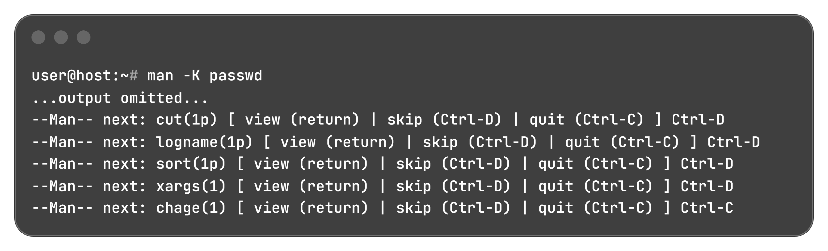
Full-Text Page Search & Search Indexing
Keyword Search Capabilities Overview:
Interactive Full-Text Page Browsing (man -K):
Displays matching pages sequentially; pressing Q exits the current document to display the next match.
Interactive Controls: View (Enter/Return), Skip (Ctrl + D), or Quit (Ctrl + C):
Command Flag | Equivalent Utility | Search Scope | System Resource Usage
-f | whatis | Titles only | Minimal
-k | apropos | Titles and descriptions (Regex) | Moderate
-K | (None) | Full text of entire manual pages | High (consumes more resources and time)
Underlying Search Index Architecture:
Keyword searches rely on an index database generated by the mandb(8) command (must be executed as root).
Handled automatically by the man-db-cache-update service whenever a package containing man pages is installed.

Slide 9
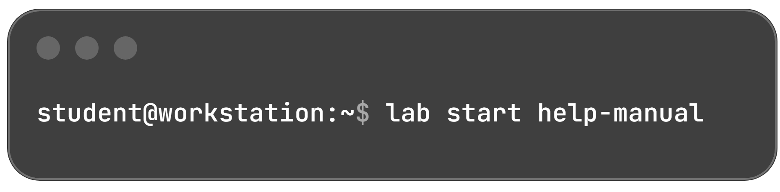
Guided Exercise: Manual Pages Overview & Setup
Run the startup script on the workstation machine to prepare the lab environment and ensure all resources are available:
Exercise Goal: Find information in local Linux system manual pages.
Core Outcome: Search and browse the Linux manual pages to locate useful operational information.
Environment Roles:
  User: student
  Host: workstation

Slide 10
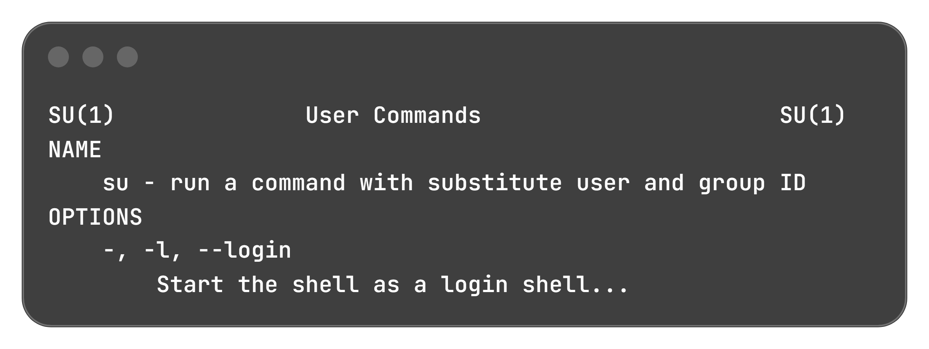
Section Distinction & Command Behavior Inspection
man man: Displays section (1) header, confirming it documents the user command interface.
man passwd (Section 1): Explains how standard users update their own password and how root modifies any account.
man 5 passwd (Section 5): Documents the /etc/passwd file format (world-readable user map; write-restricted to superuser).
Navigation Note: Press Q to exit active manual pages.
Default Target: Omitting the user argument defaults to running an interactive shell as root.
Single Dash (-): Spawns a full login shell simulating a real login environment (omitting - creates a non-login child shell inheriting current user environment).

Slide 11
Keyword Discovery & Title Lookups
Objective | Command Executed | Key Matches & Discoveries
Inspect ZIP Archive Details | $ man -k zip | zipinfo (1): Lists detailed info about ZIP archives zipnote (1): Edits comments/renames files zipsplit (1): Splits archive files
Find Kernel Boot Parameters | $ man -k boot | bootparam (7): Introduces boot time parameters for the Linux kernel bootctl (1): Controls EFI firmware boot settings
Tune ext4 File Systems | $ man -k ext4 | tune2fs (8): Adjusts tunable file system parameters resize2fs (8): Resizes ext2/ext3/ext4 file systems
Single-Line Title Lookup | $ man -f w | w (1): Shows who is logged on and what they are doing

Slide 12
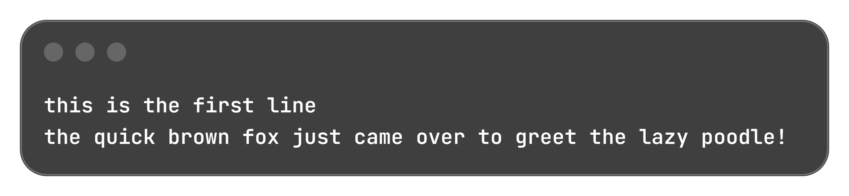
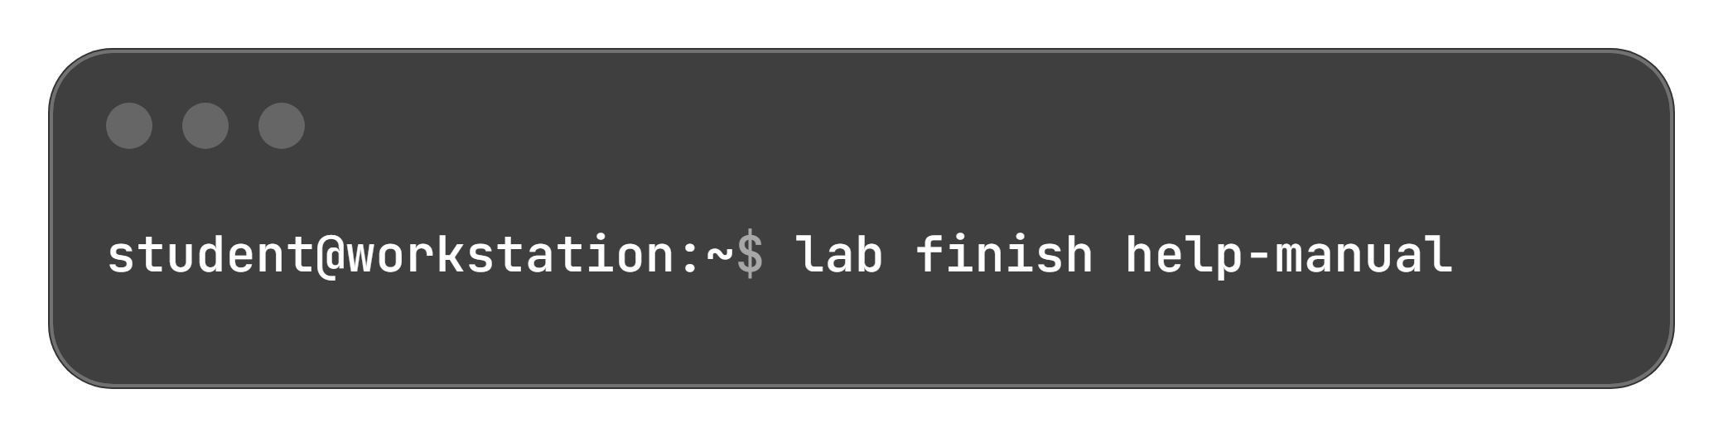
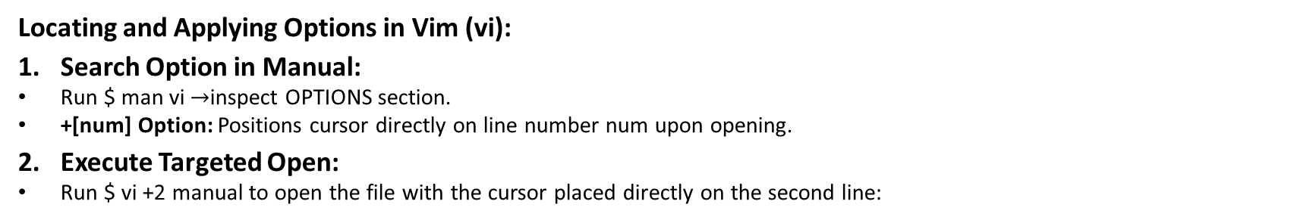
Applied Man Page Research & Lab Teardown
Locating and Applying Options in Vim (vi):
Search Option in Manual:
  Run $ man vi $→$inspect OPTIONS section.
  +[num] Option: Positions cursor directly on line number num upon opening.
Execute Targeted Open:
  Run $ vi +2 manual to open the file with the cursor placed directly on the second line:
1. Exit Editor: Type :q and press Enter.
Lab Completion:
Clean up environment resources to prevent conflicts in subsequent exercises:

Slide 13

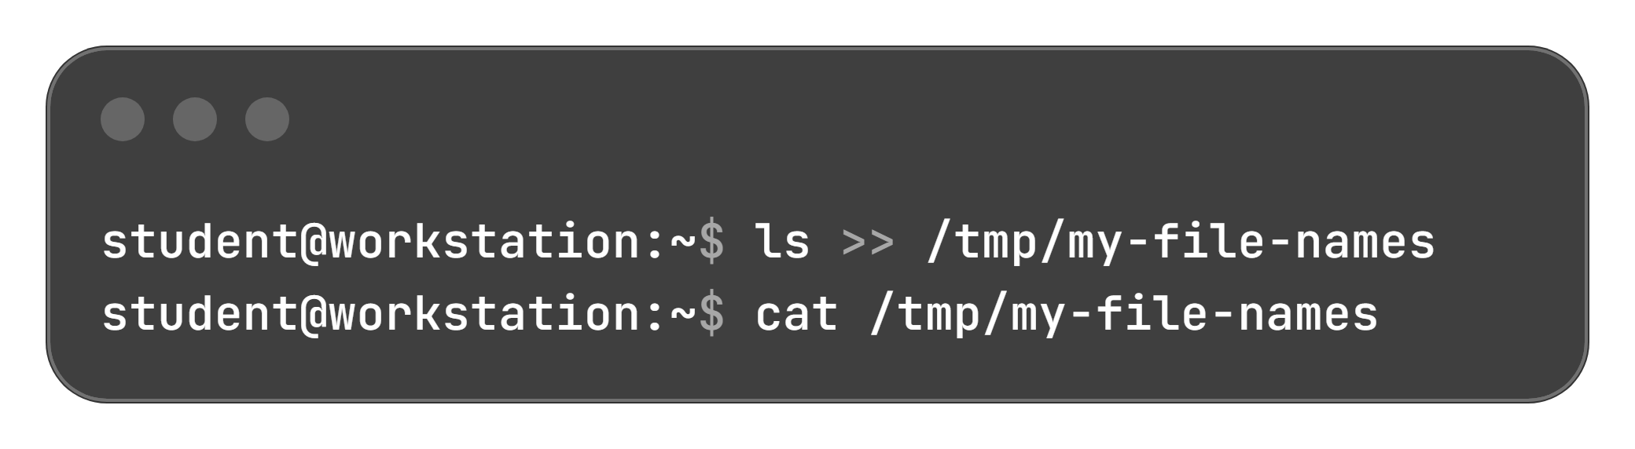
Lab Overview: Help from Local Documentation
Primary Objective: Get information from local documentation to help run commands and complete tasks.
Core Outcomes:
  Locate relevant information for commands by searching man pages.
  Explore options for common system administration commands.
Core Task: Create my_task.txt and append specific command outputs at each step.
Initialization:
Output Redirection (>>):
Two greater-than symbols (>>) append standard output to a target file.
Example Demonstration:

Slide 14
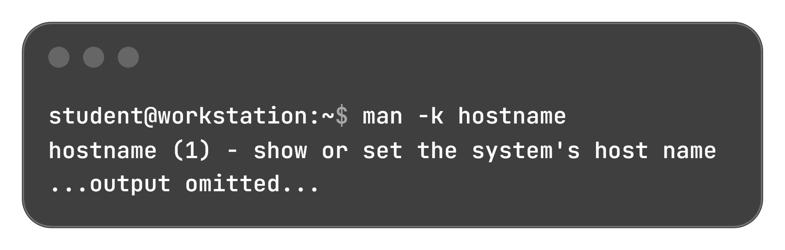
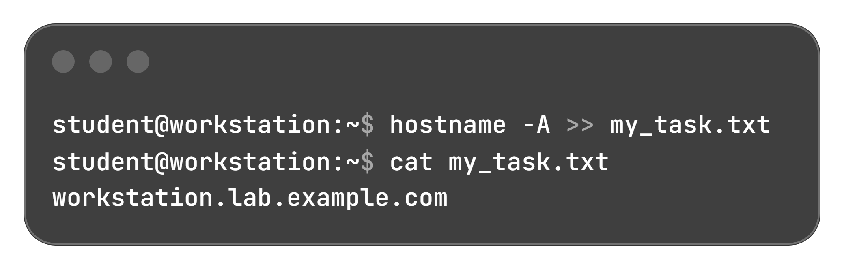
Researching & Appending Machine FQDNs
1. Locate the Manual Page:
Query the keyword index to identify the command's section:
2. Discover the Option in man hostname:
Open man hostname and inspect the OPTIONS section (press Q to exit):
  -A, --all-fqdns: Displays all FQDNs of the machine by enumerating all configured network addresses on all interfaces and translating them to DNS domain names.
3. Execute, Redirect & Verify:
Run the command with -A, append output to my_task.txt, and check contents with cat:

Slide 15
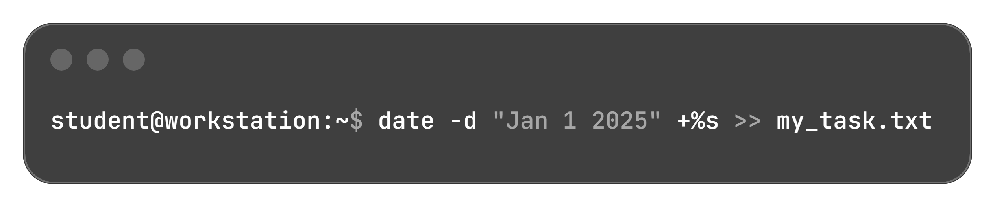
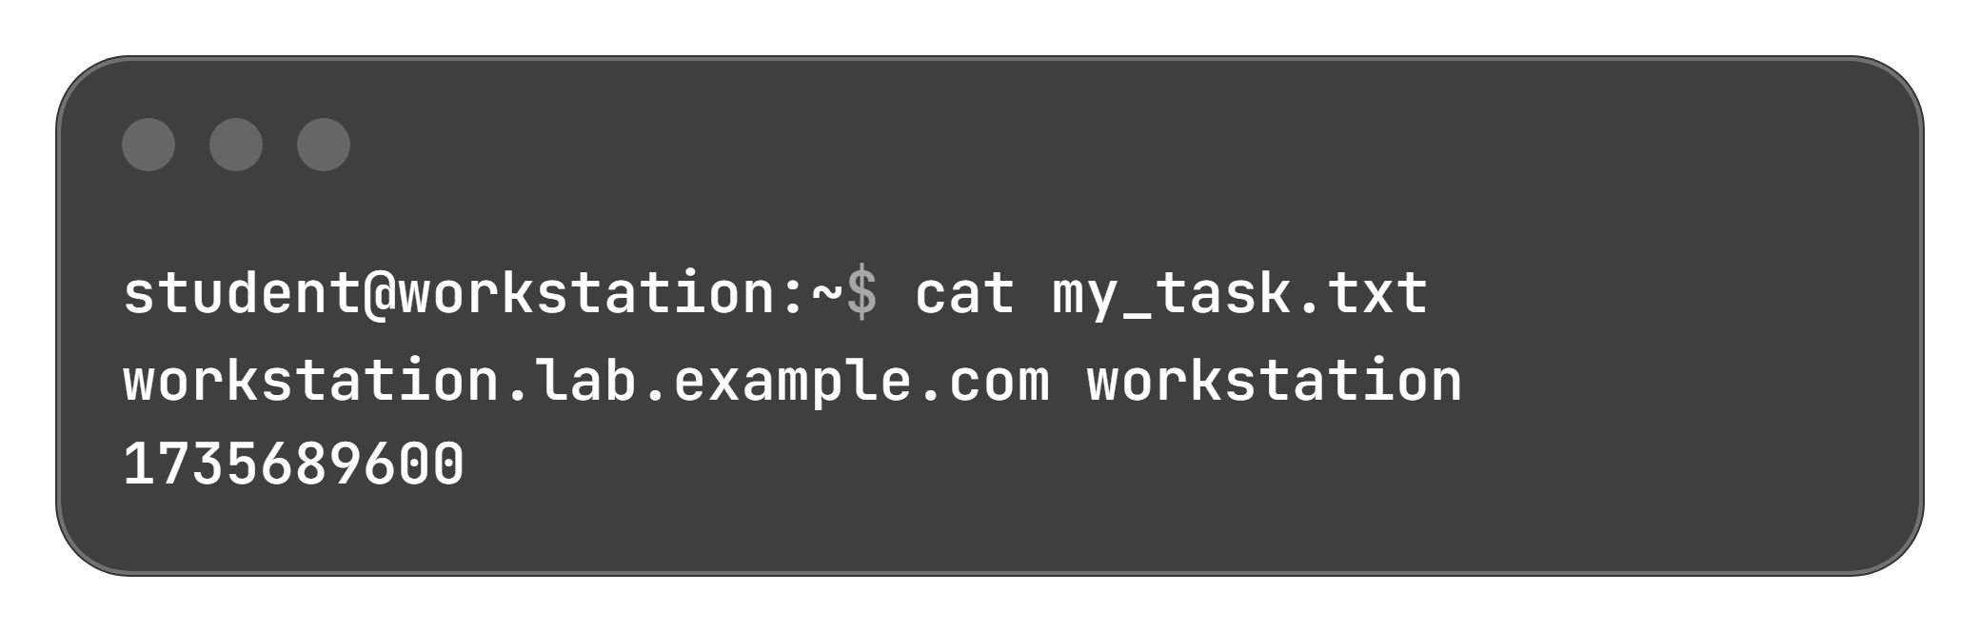
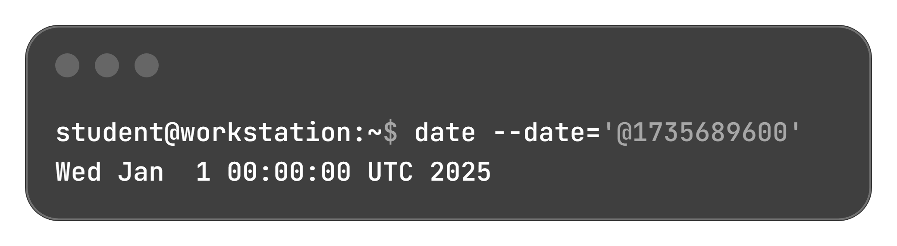
Calculating Epoch Time with the date Command
Epoch Time Definition: Represents the number of elapsed seconds since 00:00:00 UTC on January 1, 1970 on Linux systems.
Relevant Flags in man date:
  -d, --date=STRING: Displays the time described by STRING instead of the current time (now).
  +%s Format String: Outputs the exact number of seconds since the Epoch.
Navigation Note: Press Q to exit the manual viewer.
Calculate & Append to File:
Calculate elapsed seconds up to Jan 1 2025 and append the result using >>:
Verify File Contents:
Reverse Date Verification:
Validate the generated timestamp by converting the Epoch seconds back to a date string:

Slide 16
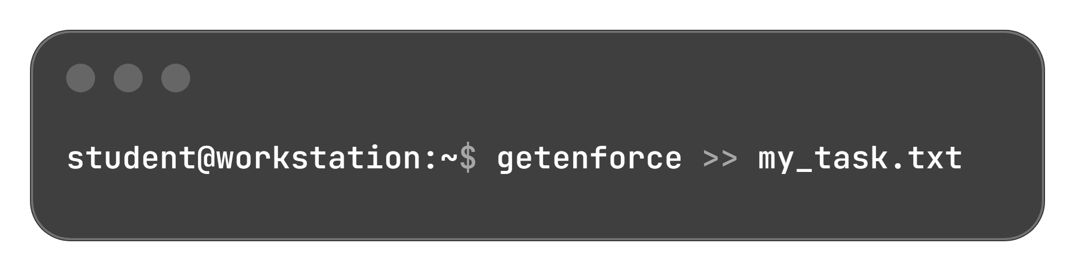
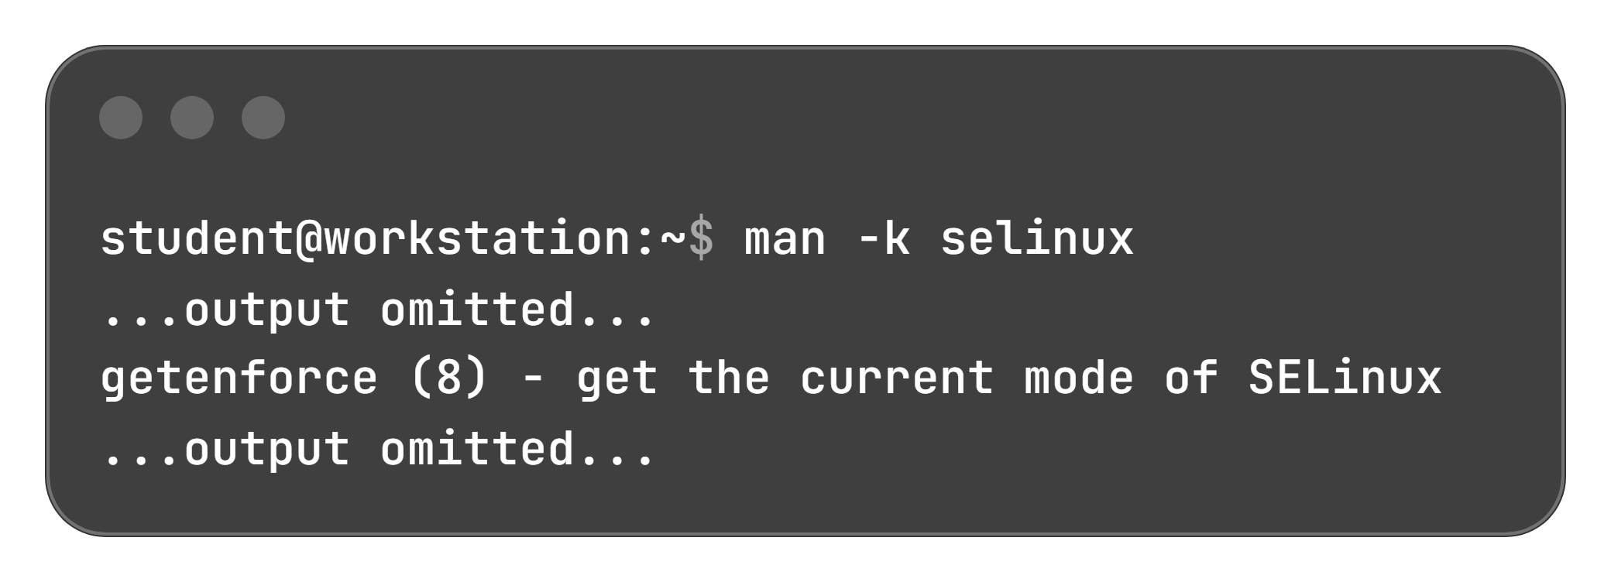
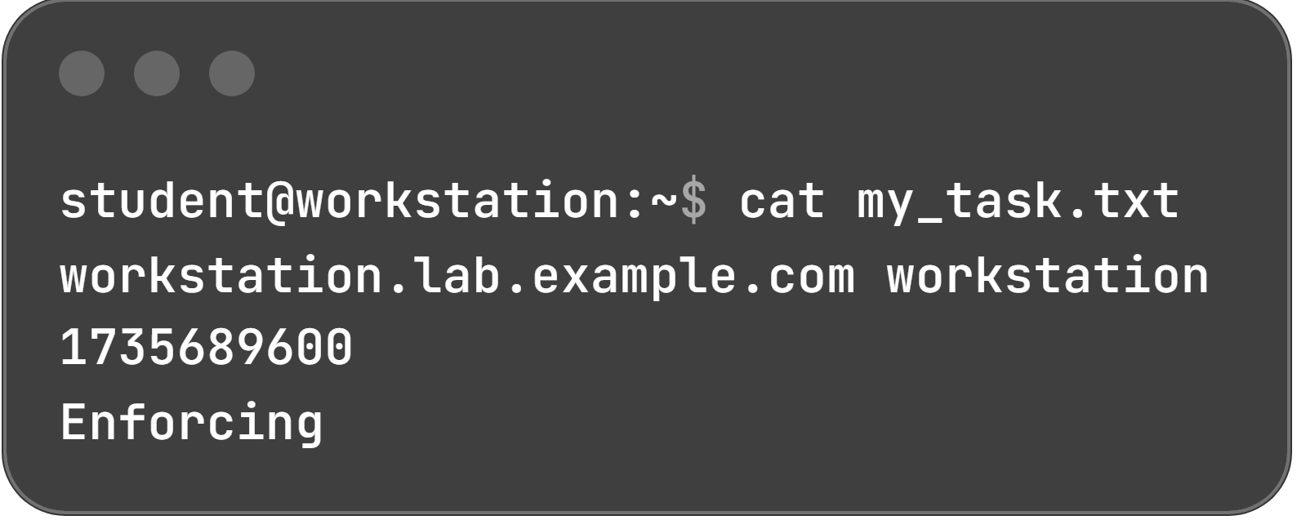
Identifying the SELinux Operating Mode
Discovery Result: getenforce(8) displays the current SELinux mode on the machine.
[Right Column: Execution & File Append]
Execute & Redirect Output:
  Run getenforce and append its output to my_task.txt using >>:
Search Objective: Identify the command responsible for displaying the machine's active SELinux operating mode.
Keyword Discovery:
  Query the manual index with man -k selinux:
Verify File Status:
View updated contents using cat:
Output State: Confirms the active state is Enforcing.

Slide 17
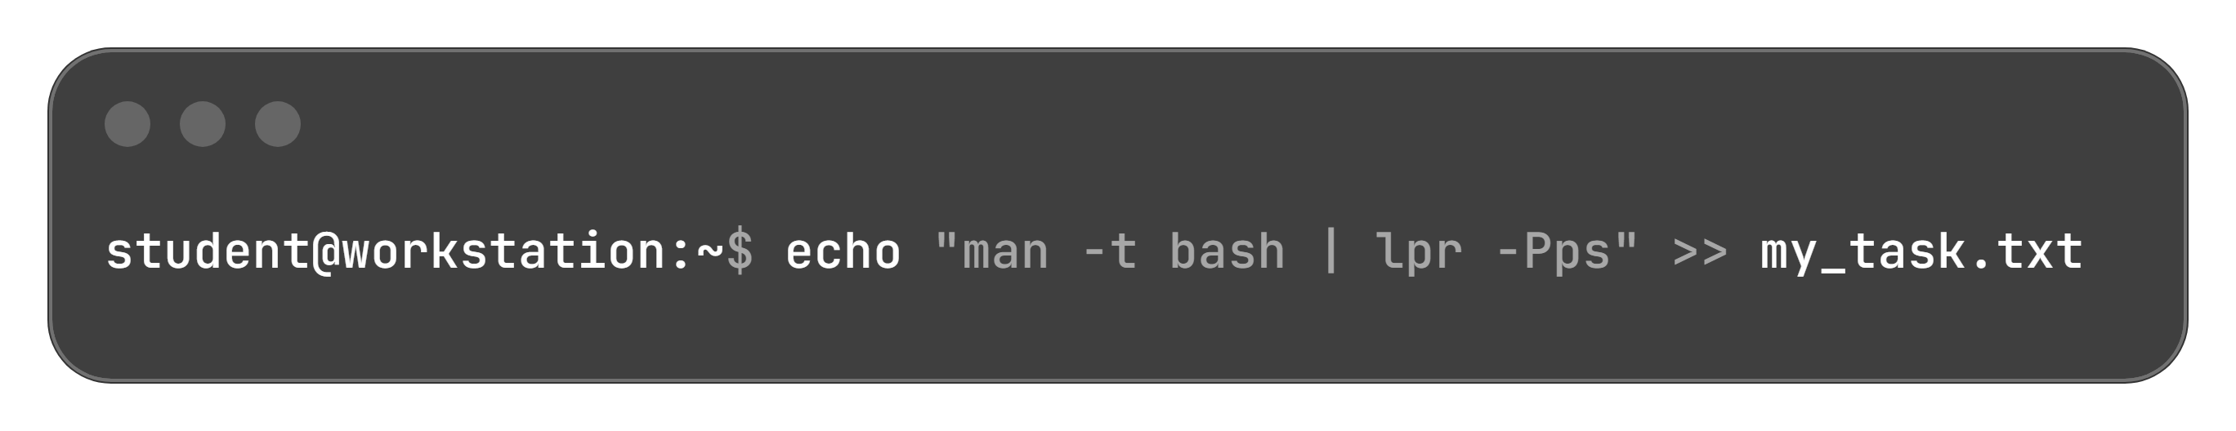
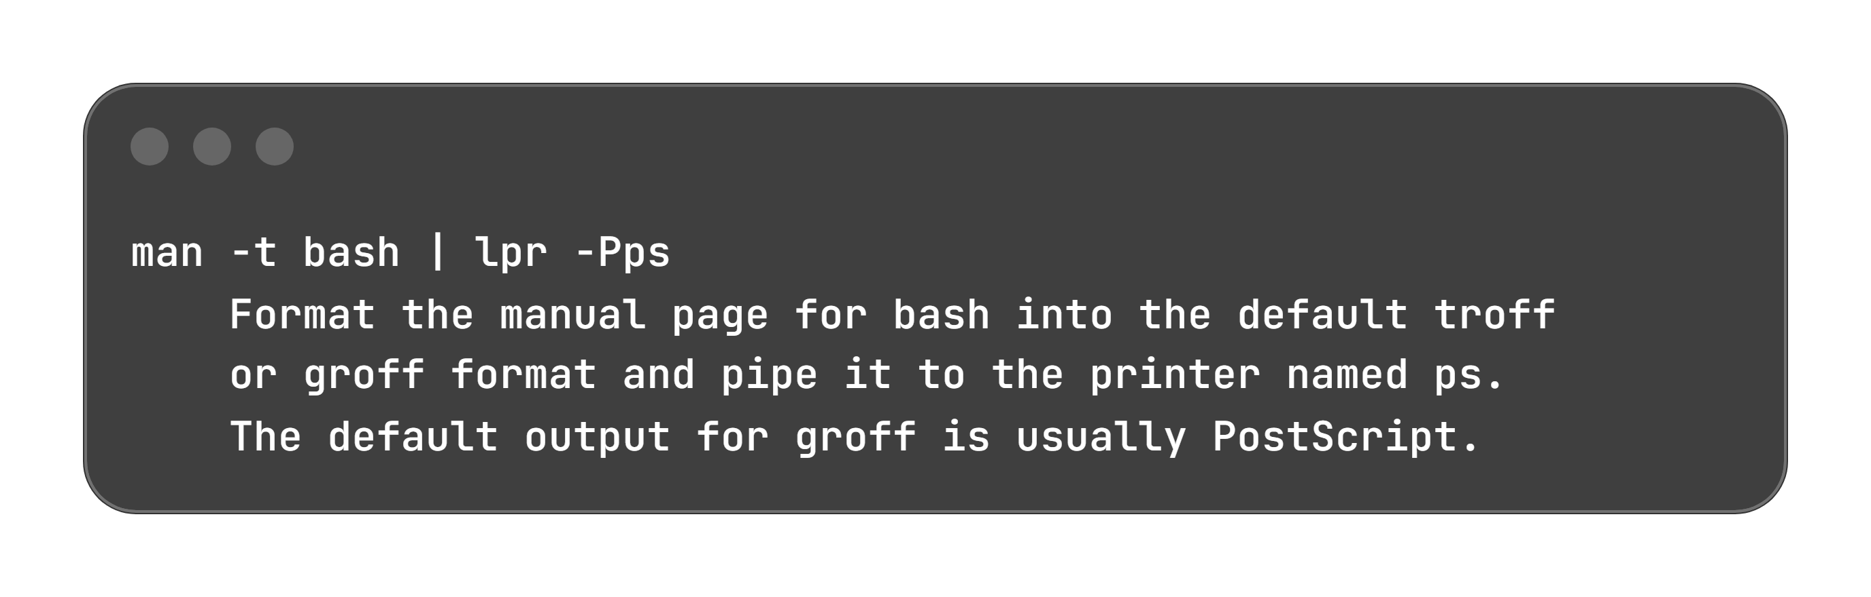
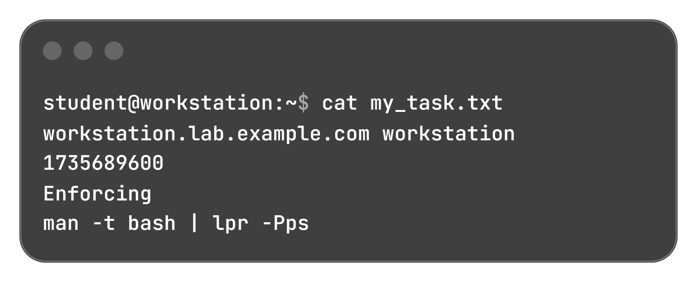
Researching PostScript Printing & Appending Commands
Target Objective: Determine how to format and print a manual page using PostScript.
Manual Inspection (man man):
  Open man man and review example pipelines (press Q to exit):
Append Command String (Not Output):
Use echo with quotes to write the literal command string into my_task.txt
Verify Cumulative File Content:
Inspect the file with cat to confirm all task entries:
Key Mechanism: The -t option binds to the document processor to produce PostScript output, piped directly to lpr.

Slide 18


Lab Evaluation & Resource Teardown
Role & Host: Executed as the student user on the workstation machine.
Assessment Workflow:
  Run the grading utility to validate all task requirements within my_task.txt.
  Review any reported failures, correct the discrepancies, and re-run until successful.
Evaluation Command:
Directory Requirement: Return to the student user home directory before running the final script.
Resource Preservation:
  Frees and resets all allocated lab components.
  Ensures resources from this exercise do not interfere with upcoming lab modules.
Finish Command:

